Slide 1
Java Collections and Streams
Dr John H Robb, PMP
UT Arlington
Computer Science and Engineering

Slide 2
Using Java Collections

Slide 3
Java Collections in This Lecture
Collections are the heart of Java
It has a number of different collection types to assist in the capture and query of data
This lecture will focus primarily on the List collection

Slide 4
Iterating Through a List
1
2
3
4
1 - final makes the assignment immutable - we want this
2 - List is a Java collection - a list of restaurant names
3 - <String> is a Java generic - it tells us the type of the List
4 - Arrays.asList makes the list an array

Slide 5
Iterating Through a List (Cont.)
This will print out each restaurant name on a separate line.
This is a very rudimentary way to do this. Several possibilities of error here e.g., < vs. <=

Slide 6
Iterating Through a List (Cont.)
A better way
This uses Java (external) Iterator instead - has less potential sources of error. But with both examples we are specifically controlling the order of printing elements.

Slide 7
Iterating Through a List (Cont.)
1) tell Java what this is (object.listname)
2) invokes the forEach method on the collection passing the anonymous instance of Consumer to it.
2
3
1
4
3) The forEach method invokes the
4) accept method of the given Consumer for each element in the collection.
Note: a Consumer is like a setter - take parameters & performs an action

Slide 8
Iterating Through a List - Functional
This is the functional equivalent of the previous code - the forEach is a higher order function that accepts a lambda expression to perform for each element in the list.
This version focuses more on what is performed for each element in the list versus how to iterate through

Slide 9
Iterating Through a List - Functional (cont.)
This is the functional equivalent of the previous code - but the type of the parameter to the forEach function is made generic so that we could pass multiple types.
This doesn't do much here but would be handy where we need to print out Strings, ints, doubles, etc.

Slide 10
Iterating Through a List - Functional (cont.)
This is the functional equivalent of the previous code - but the call to the println() method is shown as above.
Either approach can be used.

Slide 11
A Simple Example

Slide 12
Simple Example of Imperative Programming
We will implement the following table (captured in Excel) in Java

Slide 13
Java Class for the Data Table
Class Constructor
NOTE: Setters and Getters in this class are not shown

Slide 14
The Program
Go through the previous table and print out the list of Texas cities from Tarrant county that have populations > 50,000 people
The printed stream should say "<City name> is a large Texas city in <County name>"
We will look at how to do this in the traditional imperative programming approach and then with Java 8 Functional programming
The comparison between the two should provide some insight into Functional programming

Slide 15
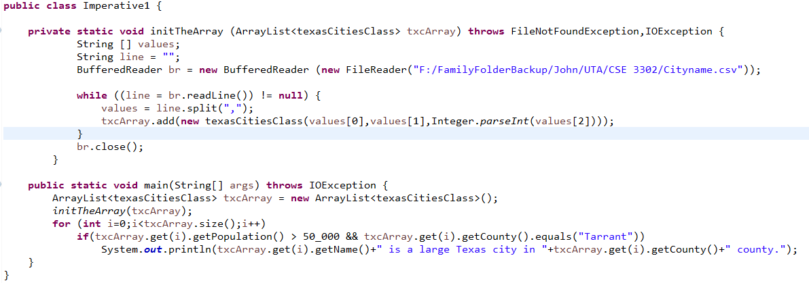
Imperative Programming Approach
1
2
3
4
6
5
1 - using BufferedReader to read a line at a time
2 - FileReader reads from a file at a given location
3 - line.split(",") lets us break up the line by commas (csv file)
4 - values is a String array
5 - use get() on a ArrayList
6 - don't compare Strings with == use instead .equals

Slide 16
Imperative Programming Approach
Output from the program:
Arlington is a large Texas city in Tarrant county.
Euless is a large Texas city in Tarrant county.
Fort Worth is a large Texas city in Tarrant county.
Grapevine is a large Texas city in Tarrant county.
Mansfield is a large Texas city in Tarrant county.
North Richland Hills is a large Texas city in Tarrant county.
What if the input table were unsorted?
Could we easily sort this using an Imperative approach?
If we use the Collections interface we could use the .sort method - is this immutable?

Slide 17
Streams

Slide 18
Streams
Streams are built into Java 8 - One of the most common uses of streams is to represent queries over data in collections.
While streams can resemble collections superficially in reality they differ significantly.
A Collection
Is a data structure; its main concern is the organization of data in memory, and a collection persists over a period of time.
Operations on collections are mutative
A Stream
Provide no storage for the elements that they process
Operation on streams are non-mutative - they do not change the source
We express a stream "pipeline" as a sequence of functional transformations
Stream pipelines can execute in any order and support parallelism (multiprocessor execution)

Slide 19
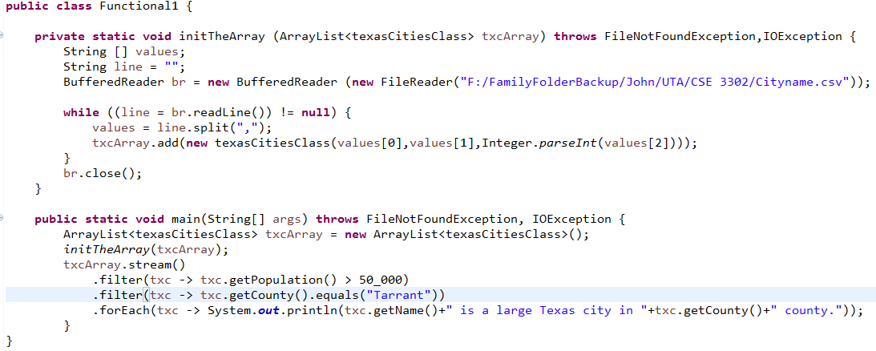
Functional Programming Approach
1
2
3
1 - using the .filter function to filter on population > 50,000
2 - using the .filter function to find county names of "Tarrant"
3 - using the .forEach to iterate over each element that matches the previous criterion

Slide 20
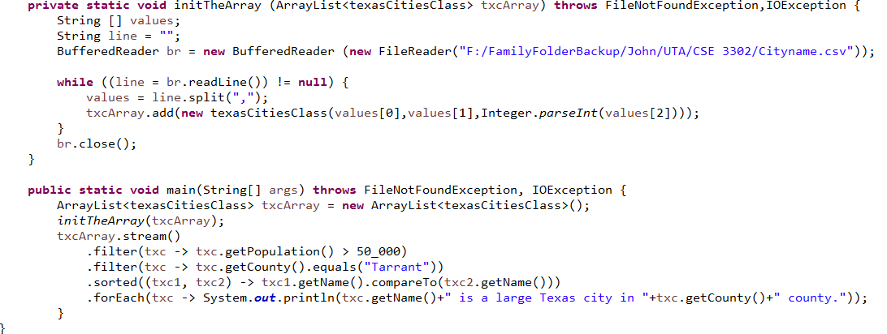
Functional Programming Approach
1
2
3
4
1 - using the .filter function to filter on population > 50,000
2 - using the .filter function to find county names of "Tarrant"
3 - using the .sorted to sort the names by integer values
4 - using the .forEach to iterate over each element that matches the previous criterion

Slide 21
Functional Programming Approach
Output from the program
Grapevine is a large Texas city in Tarrant county.
Euless is a large Texas city in Tarrant county.
Mansfield is a large Texas city in Tarrant county.
North Richland Hills is a large Texas city in Tarrant county.
Arlington is a large Texas city in Tarrant county.
Fort Worth is a large Texas city in Tarrant county.
Names are sorted by smallest to largest population size

Slide 22
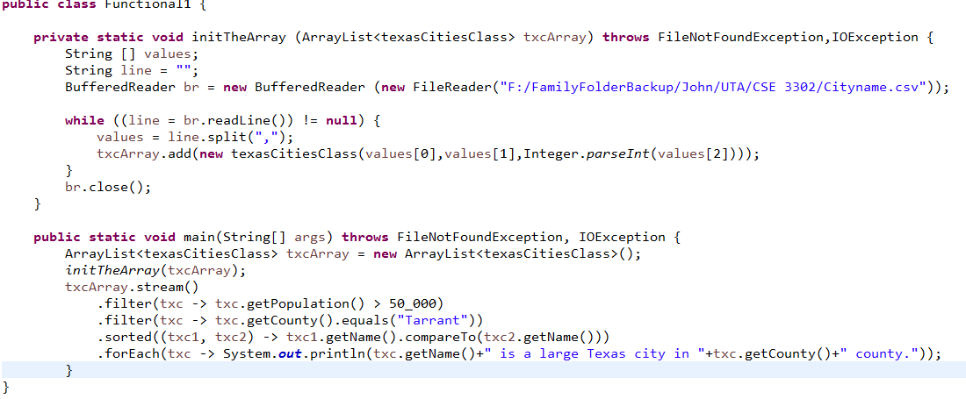
Functional Programming Approach
This example sorts by city name

Slide 23
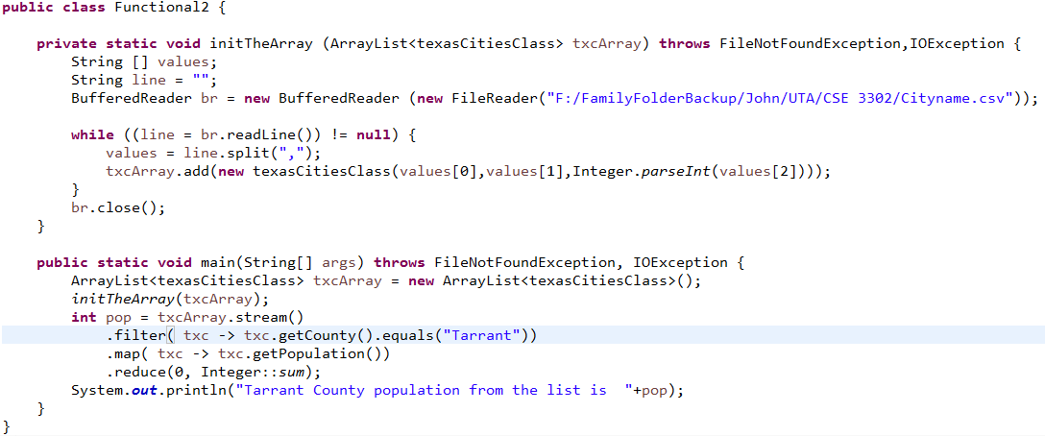
Functional Programming Approach
This example sums the population of all cities in Tarrant County

Slide 24
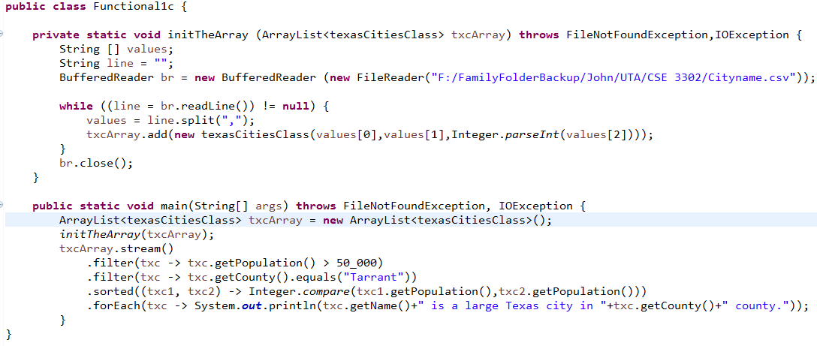
Functional Programming Approach
This example sorts by the population of all cities in Tarrant County from smallest to largest

Slide 25
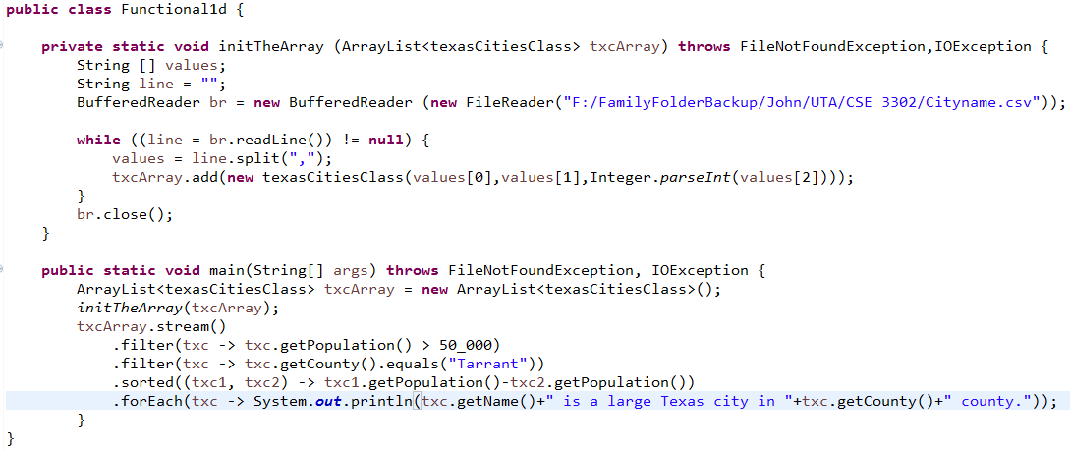
Functional Programming Approach
This example sorts by the population of all cities in Tarrant County from smallest to largest (an alternative approach)

Slide 26
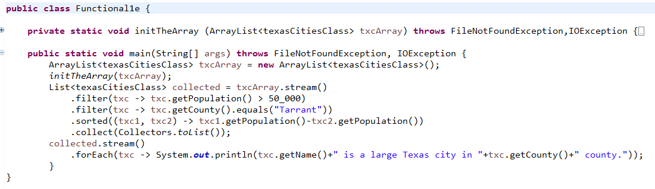
Common Stream Operations
.collect(toList()) - generates a List from a stream of values

Slide 27
Common Stream Operations (cont.)
.map - let's you convert values of one type in a stream to another type
We looked at this with the code from Functional2
.filter - selects values in the stream that meet the specified criteria
We looked at this in several previous examples
.flatMap - produces a single stream of values out of two streams
.min - minimum value in the selected stream of data
.max - maximum value in the selected stream of data
.reduce - generates a single result from a stream of values
We looked at this with the code from Functional2

Slide 28
Common Stream Operations (cont.)
.forEach - iterates through values in the selected stream
We looked at this in several previous examples
.sorted - sorts selected values in the stream according to the specified criteria
We looked at this in several previous examples (Functional 1c&1d)
.range(0,10) - selects values within the range (not inclusive)
.distinct - finds the unique elements in a stream

Slide 29
Functional Programming in Java
The combination of lambda expressions and their use in stream operations lets us write functional code
We write operations based on what needs to be done (vs. how)
We try to use as many immutable variables as possible
Developing functional code will help you understand how to write better code
Code that focuses more on function rather than implementation
Help you understand how to better organize code structure

Slide 30
Demo in Eclipse

